Slide 1
Deep learning improves global satellite observations of ocean eddy dynamics
Scott A. Martin, Georgy E. Manuchayran, and Patrice Klein

Slide 2
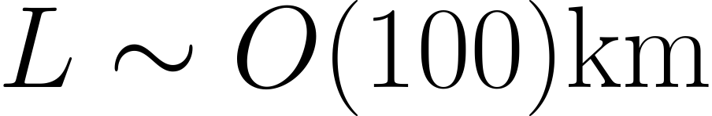
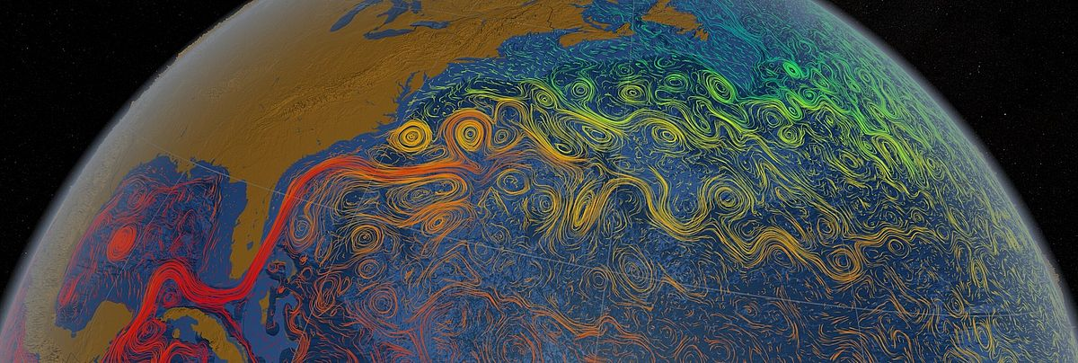
Mesoscale eddies
Swirling motions
Image: NASA/GSFC Scientific Visualization Studio

Slide 3
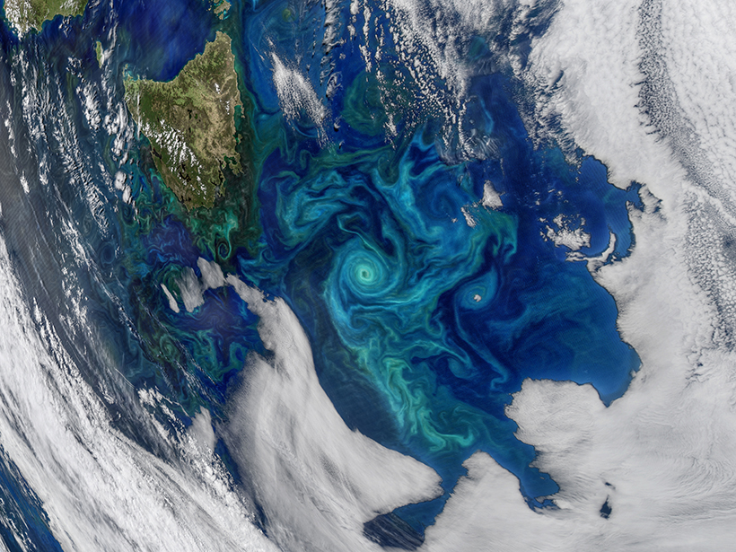
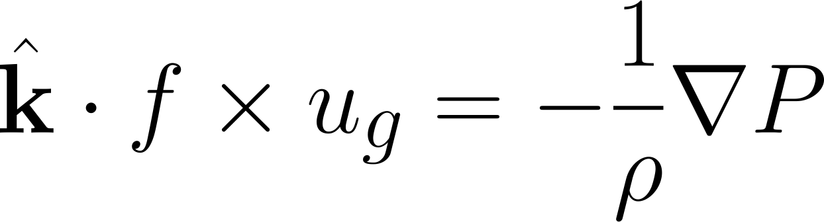
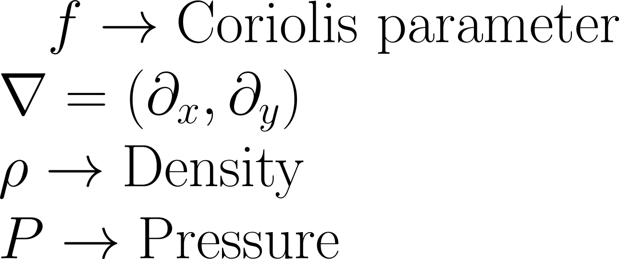
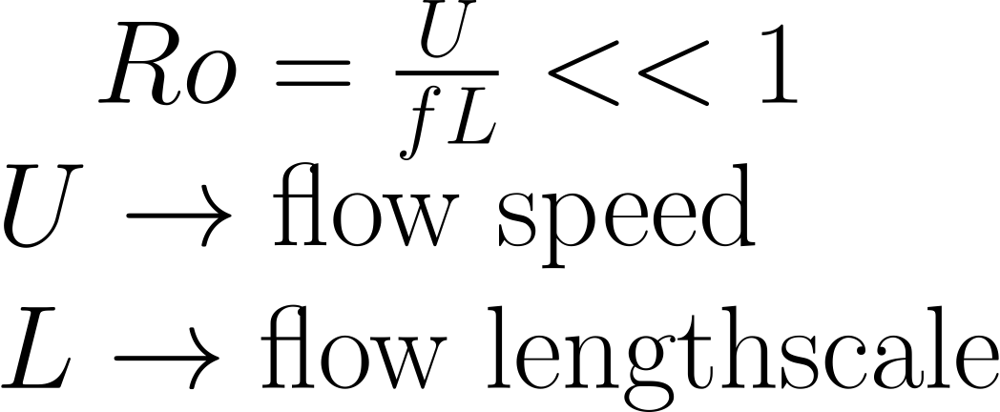
Mesoscale eddies are in geostrophic balance.
Characterize by small Rossby number
Credit: NASA/Ocean Biology Processing Group, Goddard Space Flight Center

Slide 4
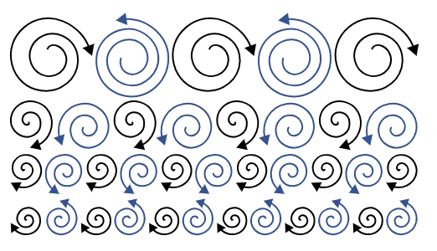
Eddies interact by exchanging energy
Forward transfer of energy:
Energy transferred to smaller eddies
Positive
Inverse transfer of energy:
Energy transferred to larger eddies
Negative
Credit: Altair AcuSolve

Slide 5
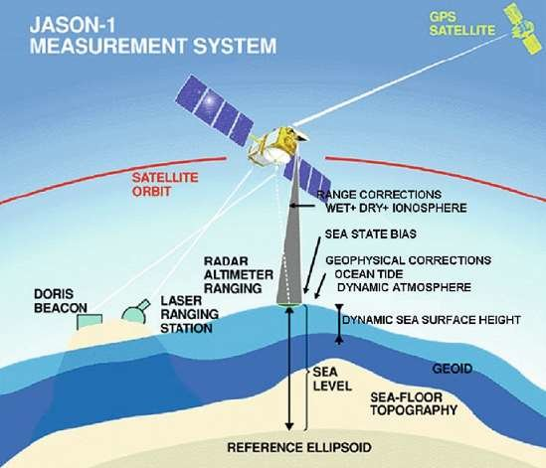
Satellite altimetry allows to surface sea level anomalies
Credit: Jason-1 Measurement system

Slide 6
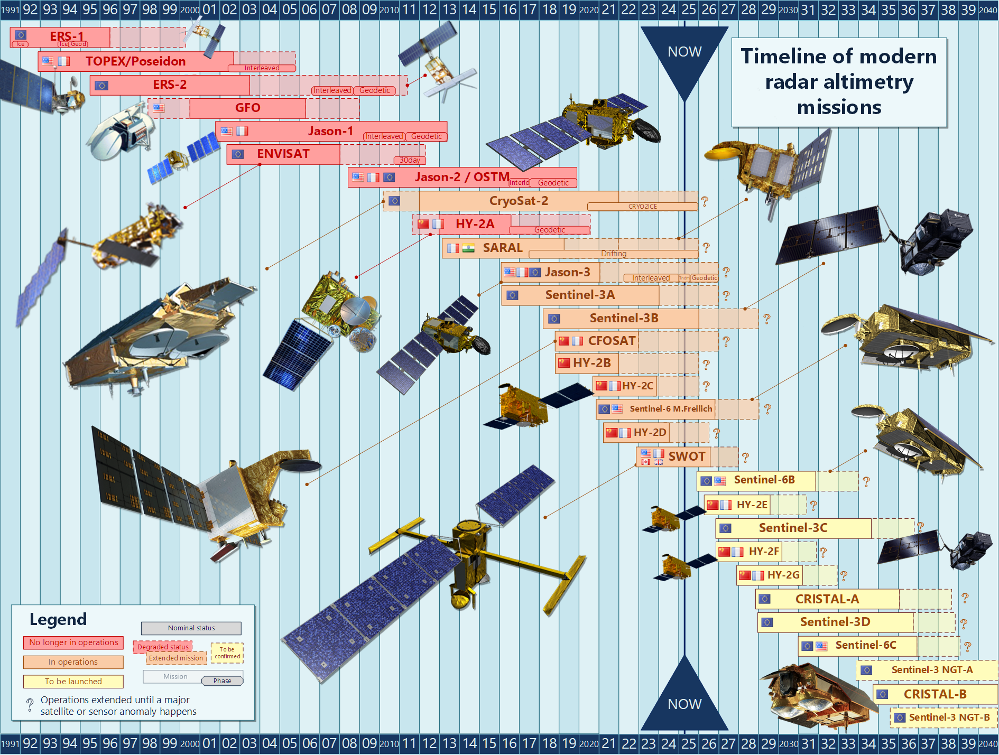
Aviso+ (2022). Timeline of modern radar altimetry missions

Slide 7
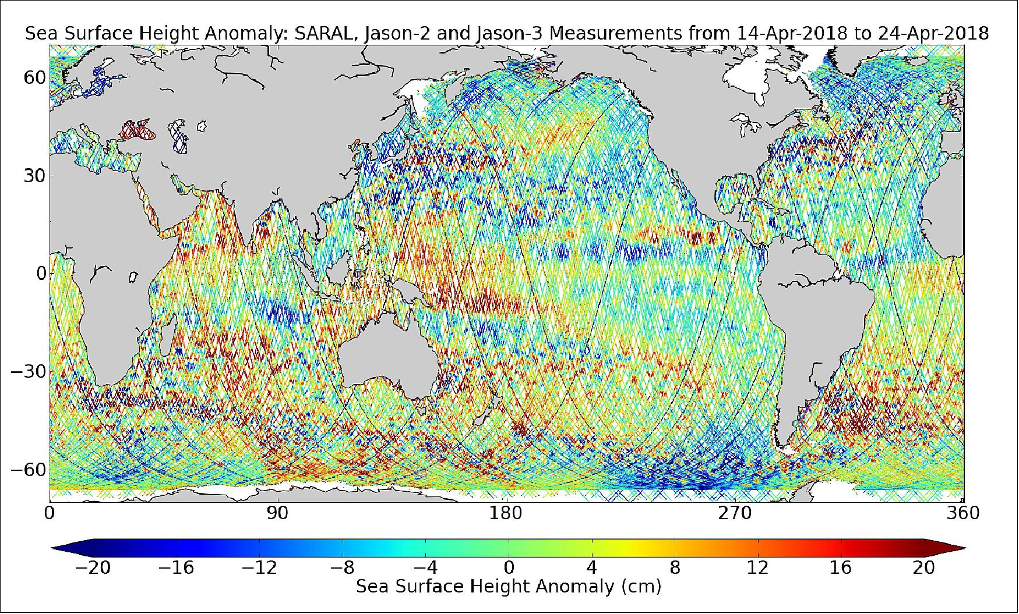
Altimetry tracks of 3 satellites
https://www.eoportal.org/satellite-missions/jason-3#mission-status

Slide 8
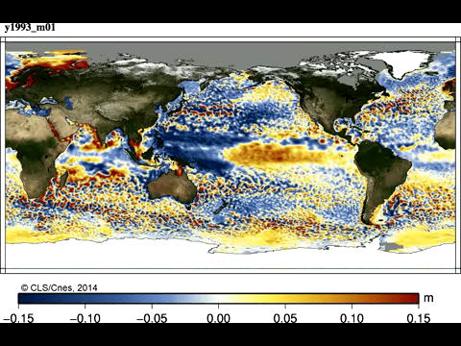
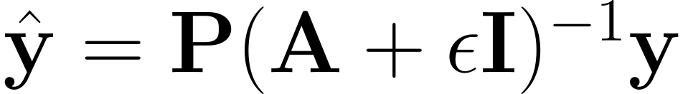
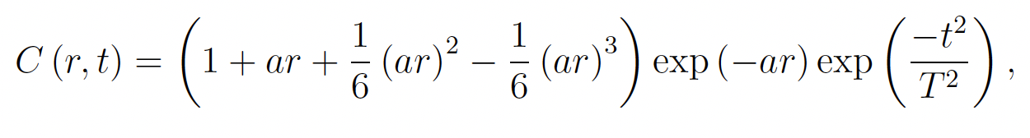
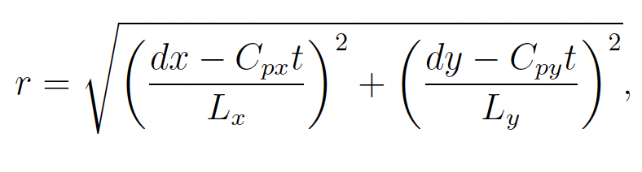
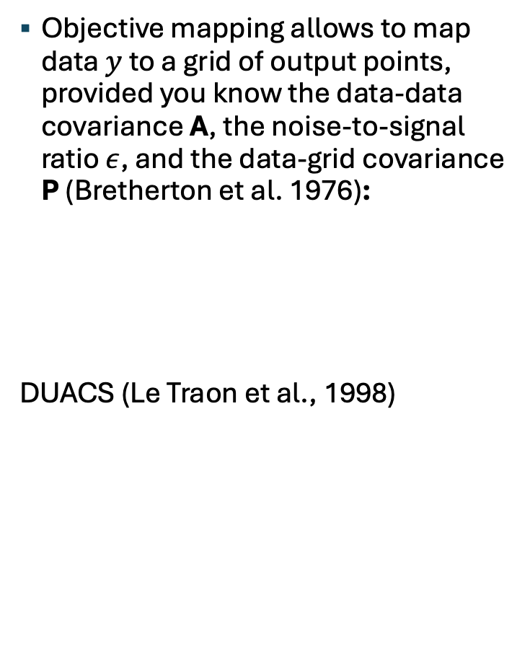
Objective mapping delivers daily maps of SSH
Objective mapping allows to map data $y$ to a grid of output points, provided you know the data-data covariance A, the noise-to-signal ratio $ε$, and the data-grid covariance P (Bretherton et al. 1976):
DUACS (Le Traon et al., 1998)

Slide 9
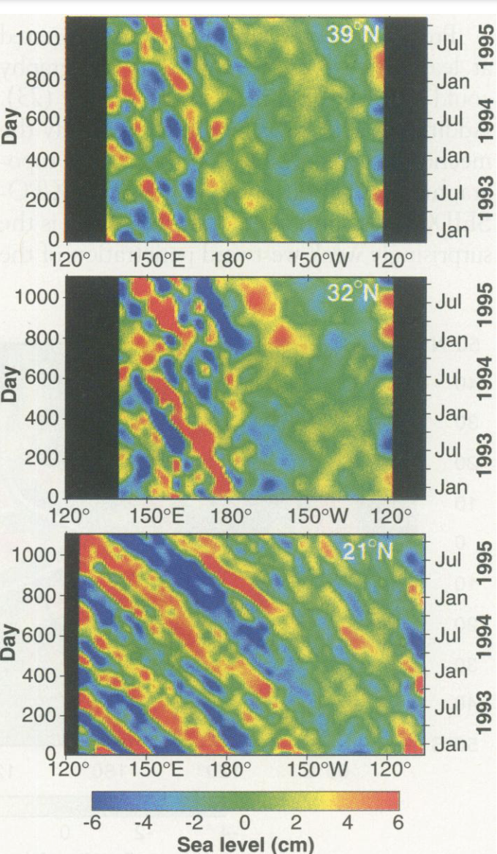
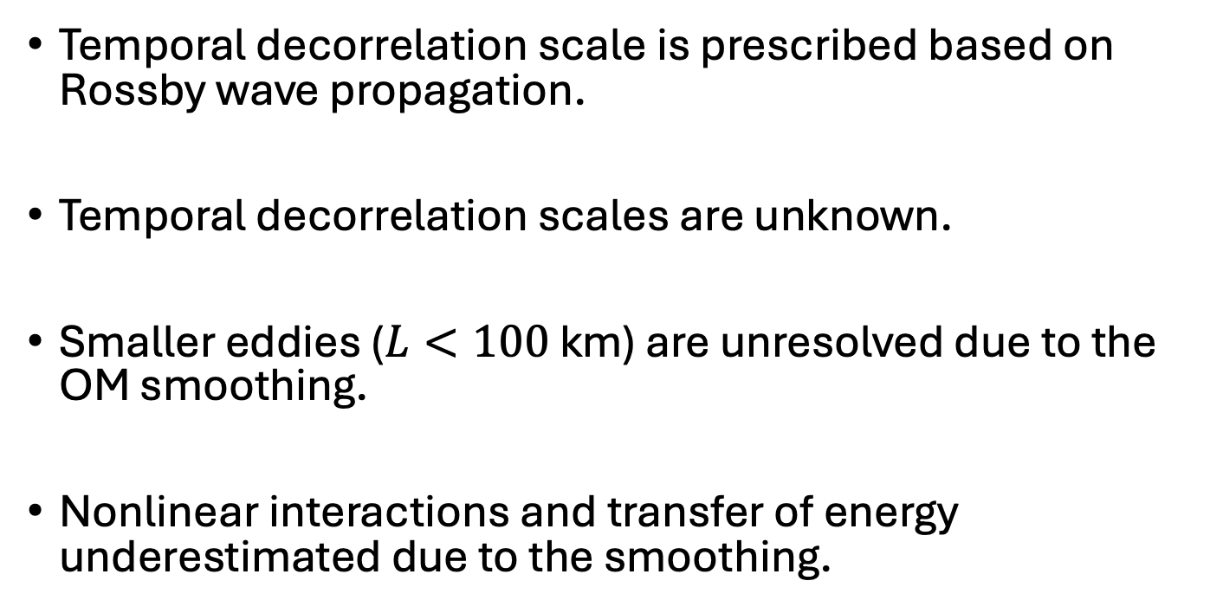
Caveats of DUACS maps
Temporal decorrelation scale is prescribed based on Rossby wave propagation.
Temporal decorrelation scales are unknown.
Smaller eddies ($L<100$ km) are unresolved due to the OM smoothing.
Nonlinear interactions and transfer of energy underestimated due to the smoothing.
Chelton and Schlax (1996)

Slide 10
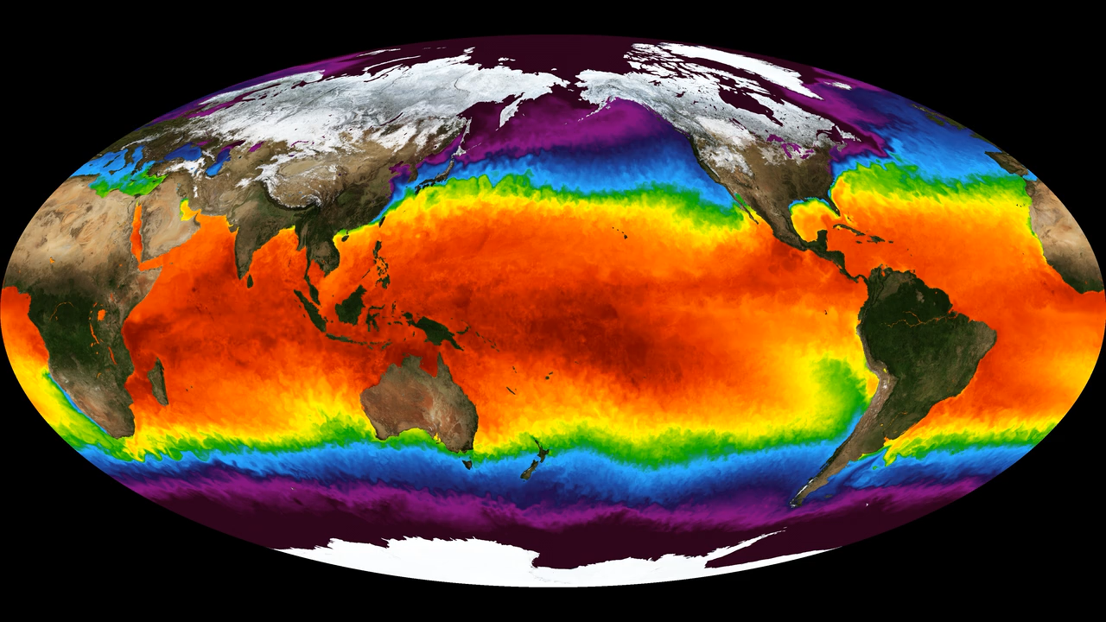
NeurOST: Neural Ocean surface topography
Neural Network to map SSH:
Sparse altimeter observations (CMEMS)
Gridded SST (JPL MUR MEaSUREs Project)
https://podaac.jpl.nasa.gov/MEaSUREs-MUR

Slide 11
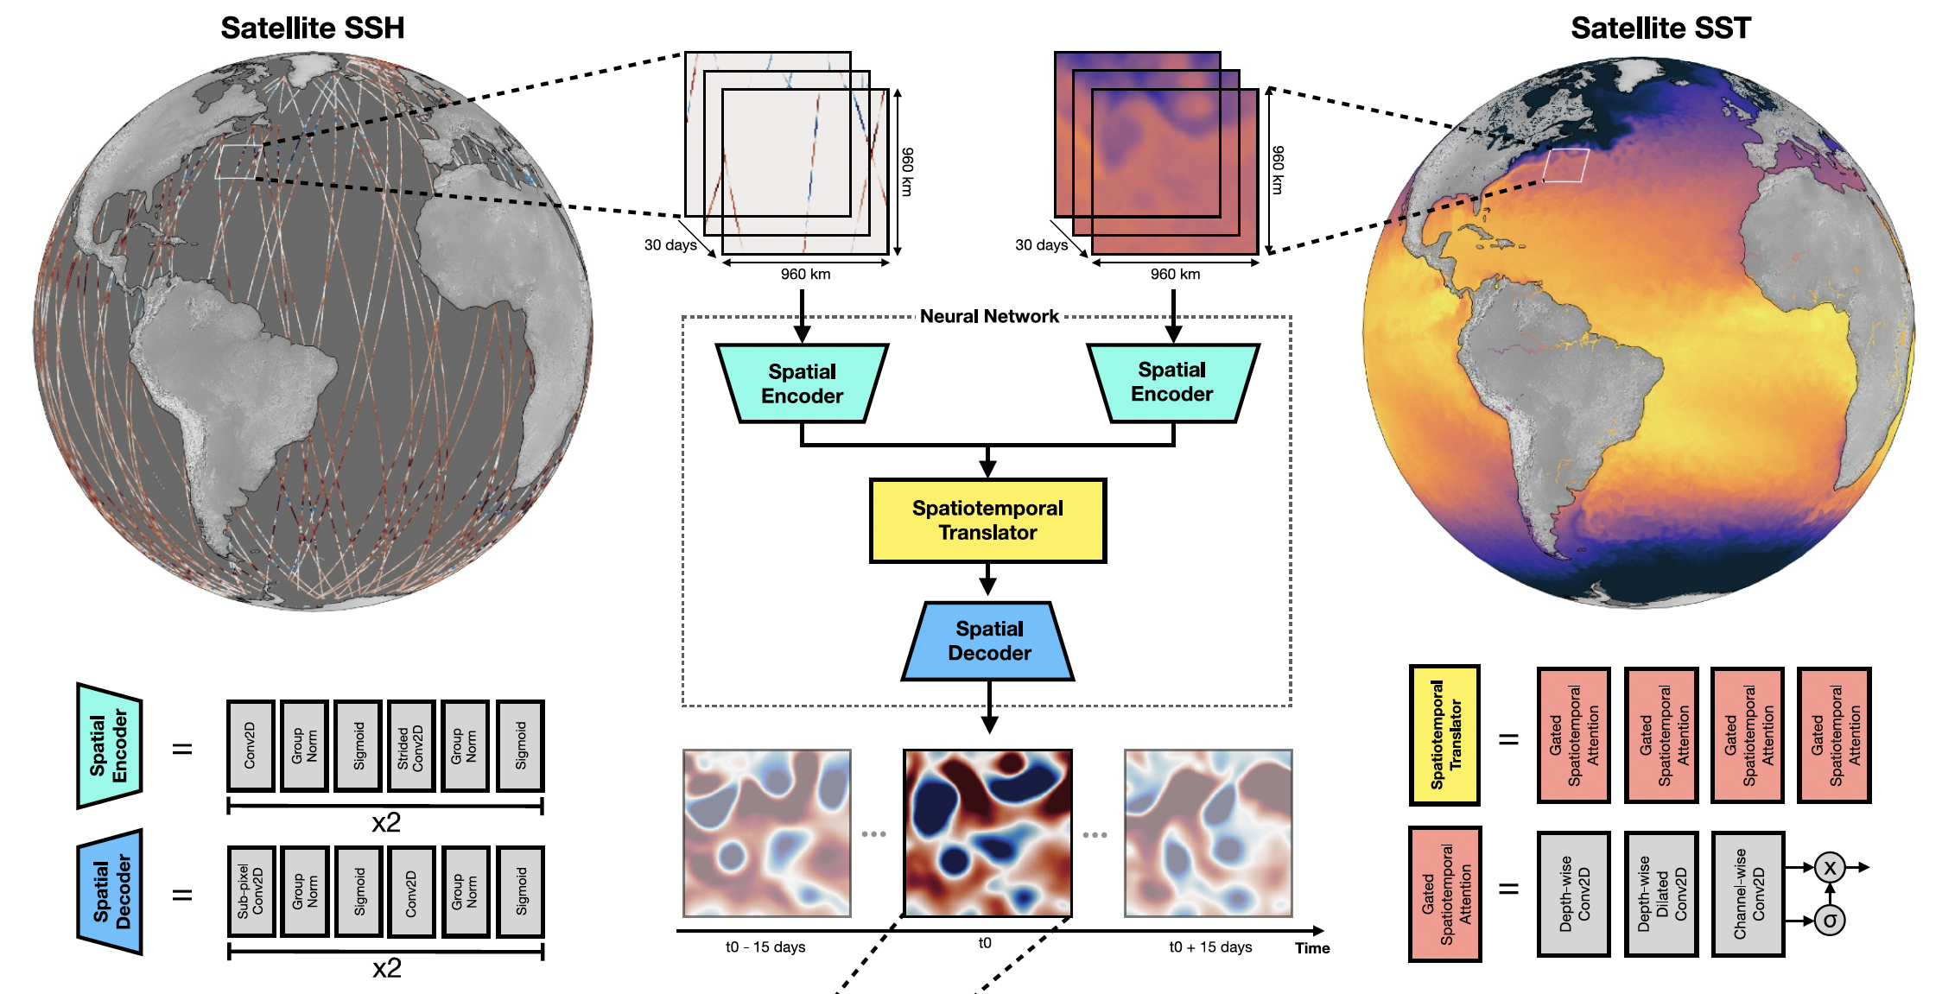
Extract satellite altimeter SSH observations for a subdomain.
Subdomain is discretized into a regular grid space (128x128, dx=7.5 km) and time (30 frames, dt=1 day).

Slide 12
Random withholding of some of the altimetry data from the input to estimate MSE at these locations.
SST observations averaged within the local grid as additional input.
Deep learning neural network architecture
SimVP (Gao et al., 2022): CNN that separates temporal and spatial modeling.
Improves efficiency and interpretability.
Easy parallelization.
Matches state-of-the-art models on standard video prediction.

Slide 13
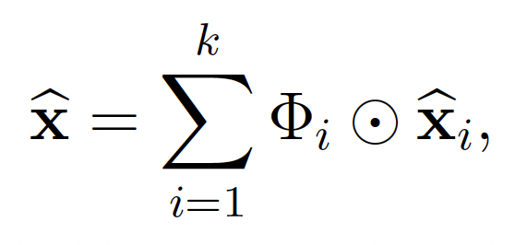
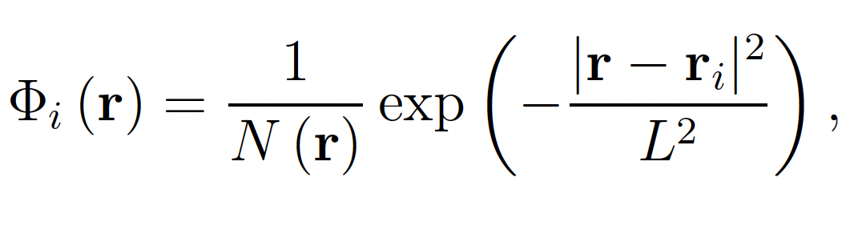
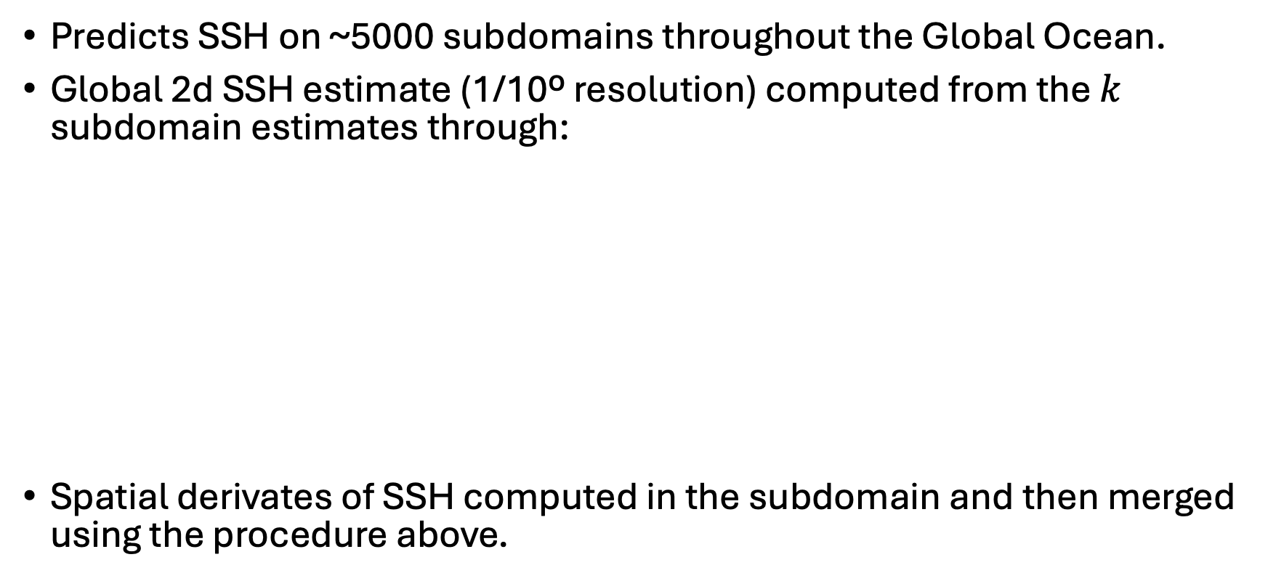
Creating global SSH from subdomain reconstructions
Predicts SSH on ~5000 subdomains throughout the Global Ocean.
Global 2d SSH estimate (1/10º resolution) computed from the $k$ subdomain estimates through:
Spatial derivates of SSH computed in the subdomain and then merged using the procedure above.

Slide 14
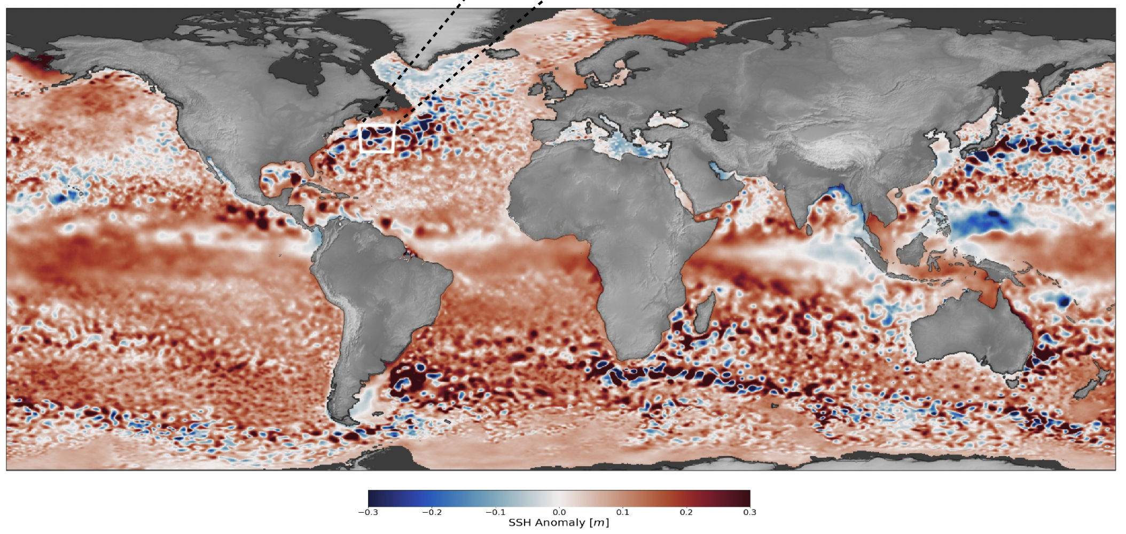
NeurOST: SSH anomalies

Slide 15
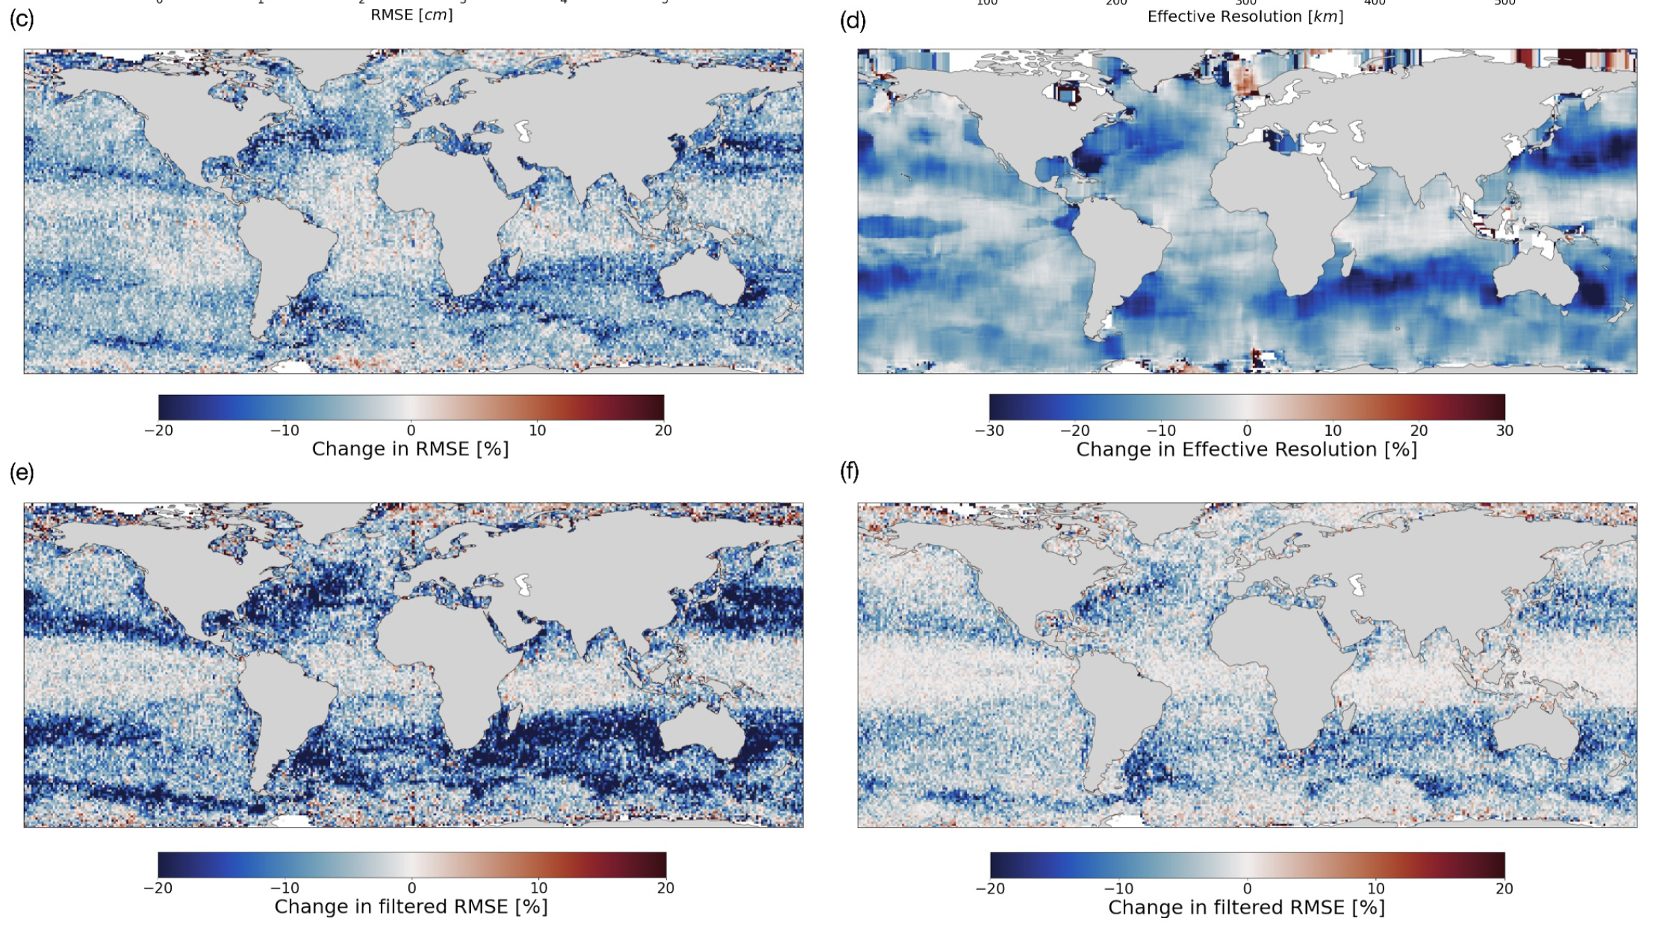
NeurOST SSH-SST vs withheld altimeter
NeurOST SSH-SST vs NeurOST SSH
(70-250 km)
NeurOST SSH-SST vs DUACS
(70-250 km)

Slide 16
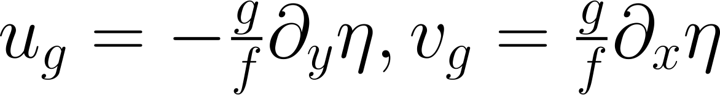
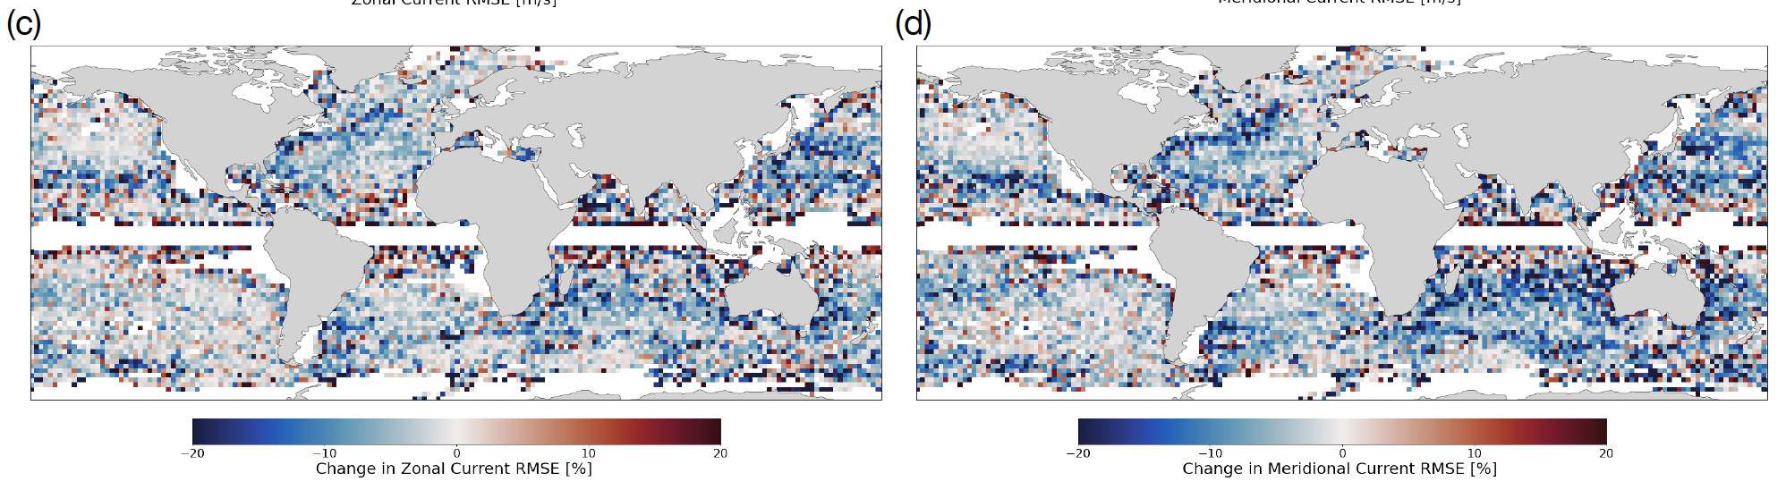
NeurOST SSH-SST vs withheld altimeter
Geostrophic velocities from DUACS calculated from gradients in SSH.

Slide 17
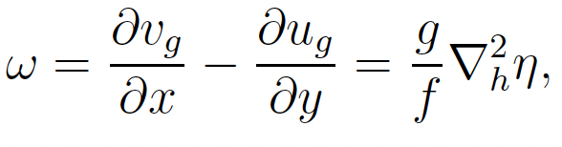
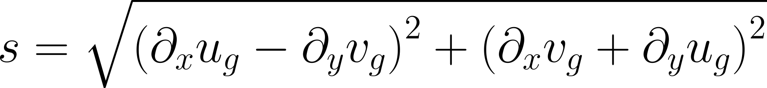
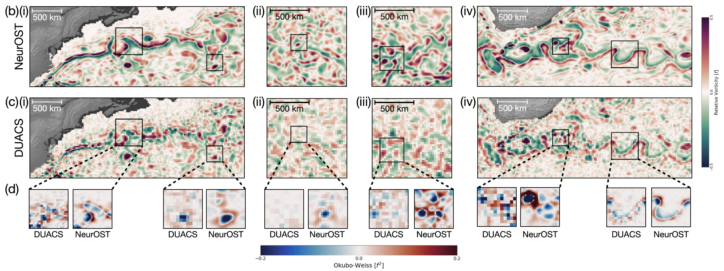
NeurOST vs DUACS: 2nd order derivatives
Vorticity
Strain rate

Slide 18
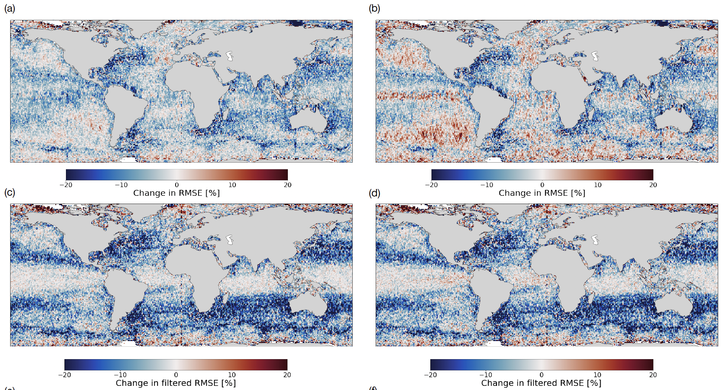
NeurOST SSH-SST vs MIOST
MIOST (geos): Single component in covariance model
MIOST (geos + waves): Adds propagation of Tropical Instabilities and Poincare waves
MIOST (geos)
MIOST (geos + waves)
70-250 km
70-250 km

Slide 19
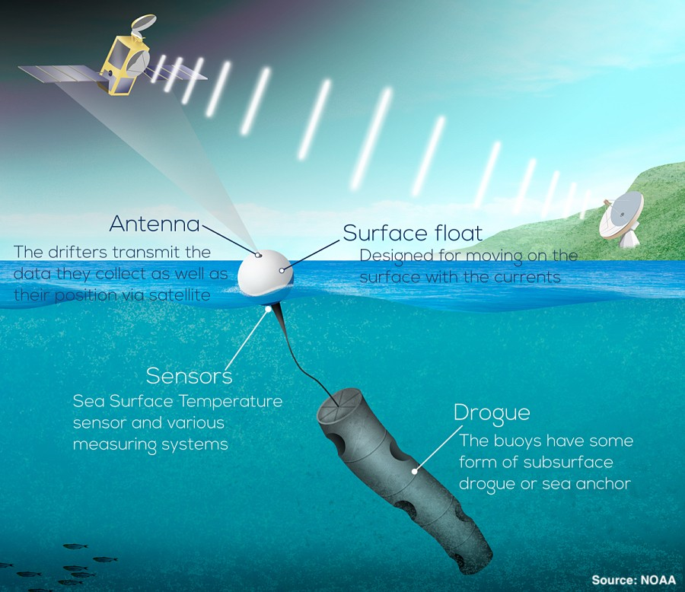
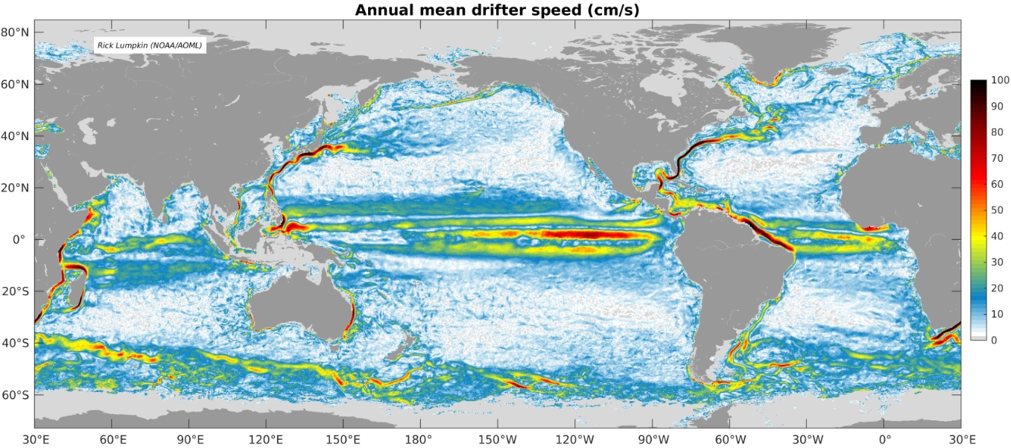
NeurOST SSH-SST vs surface drifters
https://www.aoml.noaa.gov/phod/gdp/mean_velocity.php
https://www.aoml.noaa.gov/global-drifter-program/

Slide 20
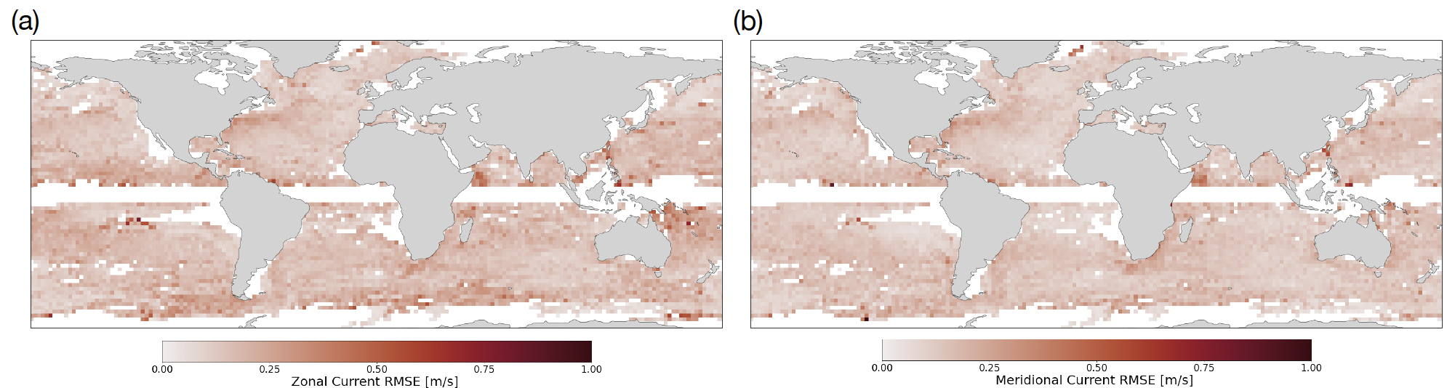
NeurOST SSH-SST vs surface drifters
Zonal and Meridional currents

Slide 21
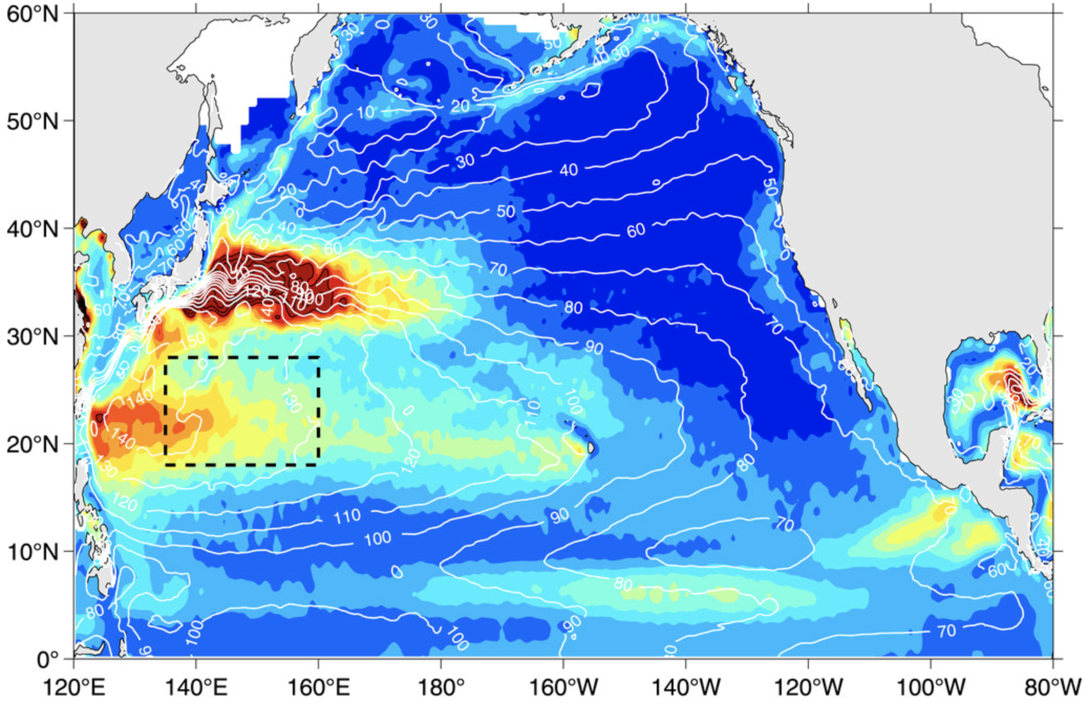
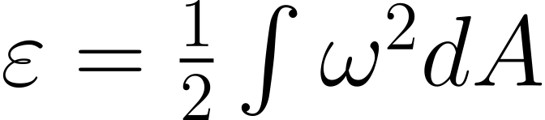
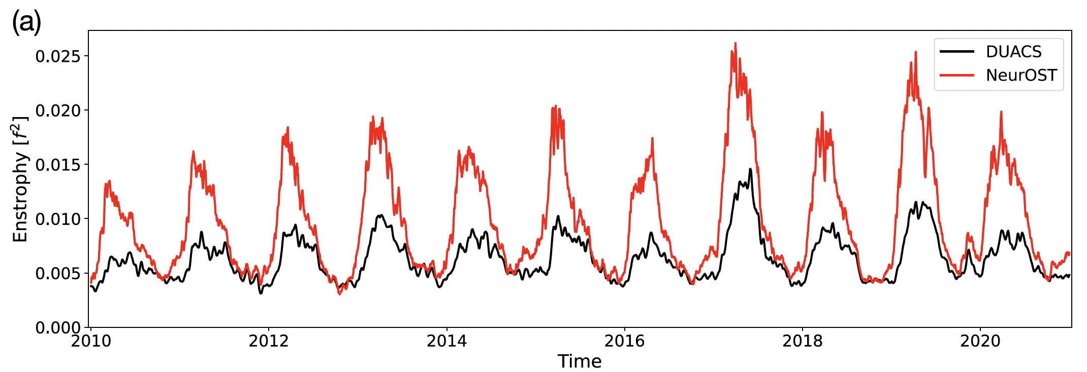
Enstrophy
Qiu et al. (2014)
Measures the intensity of the vorticity. Smaller eddies have higher vorticity, thus, enstrophy.

Slide 22
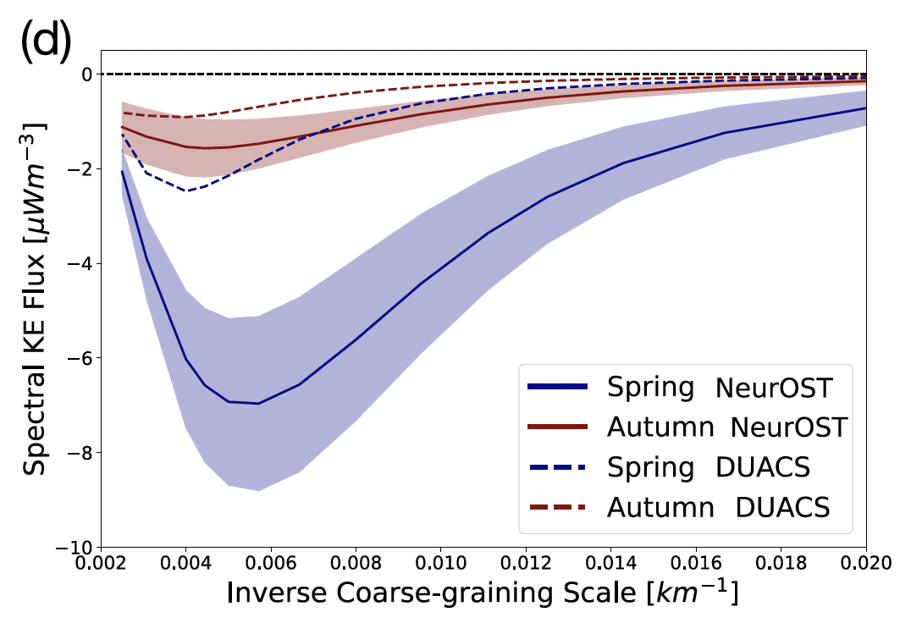
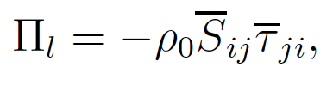
Kinetic Energy cascade transfers
Transfers estimated using coarse graining (Leonard 1979; Aluie et al. 2018).
KE transfers sensitive to flow deformation and geometry.

Slide 23
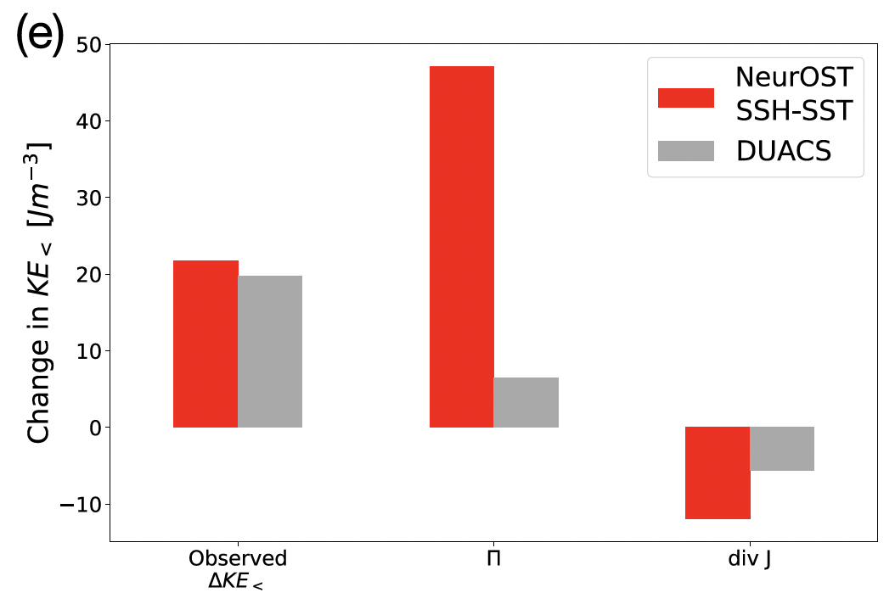
NeurOST KE transfers
KE transfers from NeurOST are sufficient to explain the Winter-to-Spring change in KE.
DUACS underestimates the KE transfers.

Slide 24
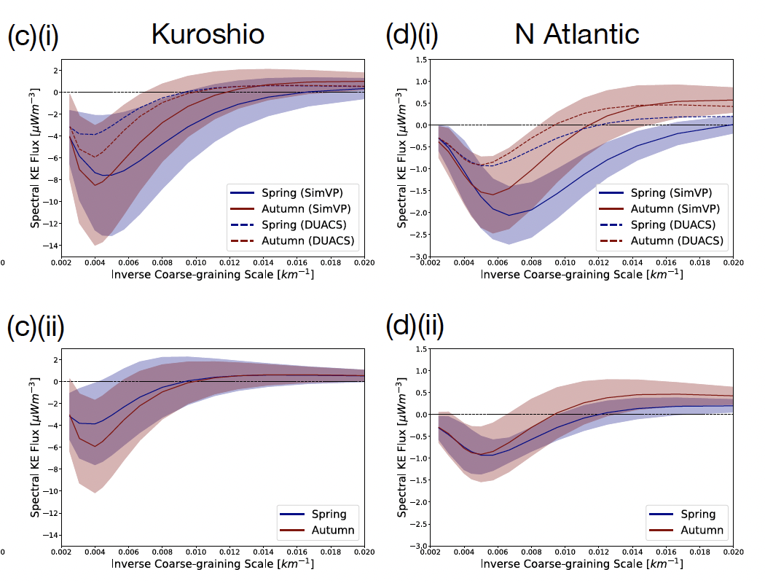
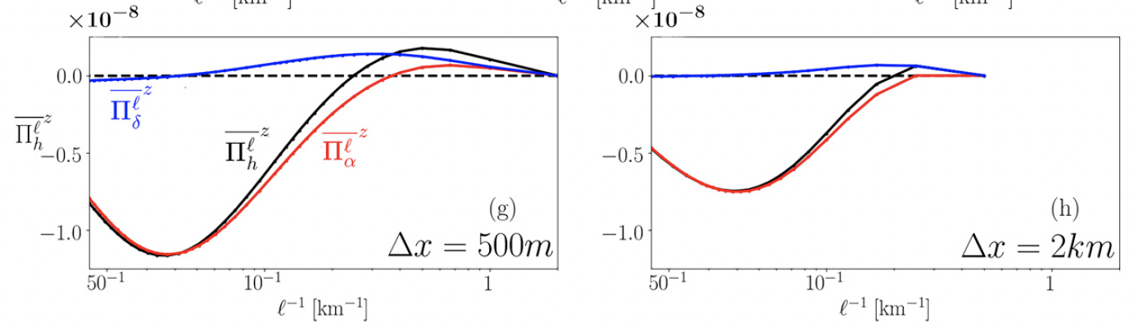
NeurOST KE transfers
Srinivasan et al. (2023): Forward cascade at submesoscales is suppressed when calculated using daily and coarse (2 km) fields.

Slide 25
Discussion
How does NeurOST infer eddies from SSH + SST? Does it leverages expected dynamics?
Polar regions assessment: why does NeurOST perform poorly in those regions? What other datasets could be useful to increase the performance of NeurOST in high-latitude environments?
Does one global model adequately capture distinct dynamics in boundary currents vs. tropical vs. high-latitude regions?
Ageostrophic corrections seem to be improve only 10%. How can NeurOST improve those corrections specially in frontal regions where ageostrophic component is large?
How can NeurOST benefit from new and upcoming satellite missions that resolve submesoscale processes?
Energy balance in NeurOST.

